Slide 1
DIABETIC RETINOPATHY
Dr. NGUYEN THI MAI HUONG

Slide 2
Diabetes mellitus (DM) is a common metabolic disorder characterized by varying degrees of hyperglycemia, which gradually causes a decrease or inactivation of endogenous insulin.
Diabetes mellitus includes: insulin-dependent( IDDM) or non-insulin-dependent(NIDDM).

Slide 3
COMPLICATIONS OF DIABETES
Frequent
Retinal disease
Damage to the iris
Unstable refraction
Uncommon
Recurrent stye
Xanthelasmata
Early and rapidly progessive cataracts
Neovascular glaucoma
Paralysis of oculomotor nerve
Rarely
Pupilary disease
Wolfram syndrome

Slide 4
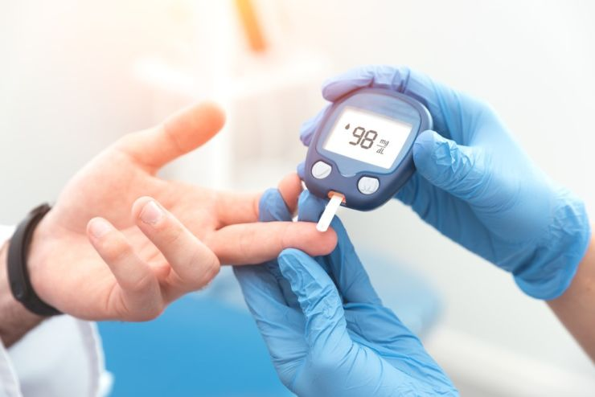
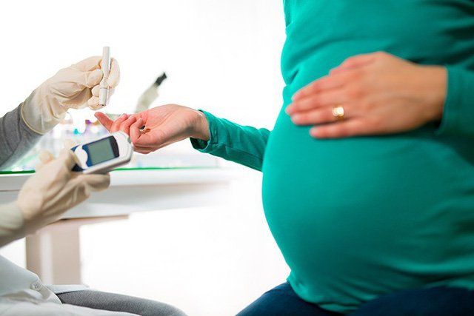
THE DANGER ELEMENTS
• Duration of diabetes: is most important. Of patients with diabetes before 30 years old, with diabetic retinopathy after 10 years is 50% and after 30 years is 90%. Diabetic retinopathy rarely develops after 5 years of diabetes or before puberty. But about 5% of type 2 diabetics have diabetic retinopathy at their first visit. • Poor glycemic control: not as important as the duration of diabetes, but is associated with progression of diabetes. • Pregnant women: may accelerate the progression of diabetic retinopathy. Factors that can make the disease worse include: diabetes aggravates during pregnancy, so it is necessary to have good glycemic control and general health when pregnant.

Slide 5
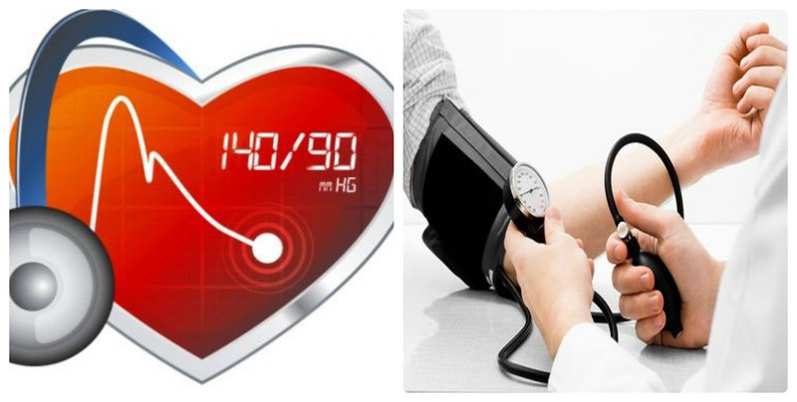
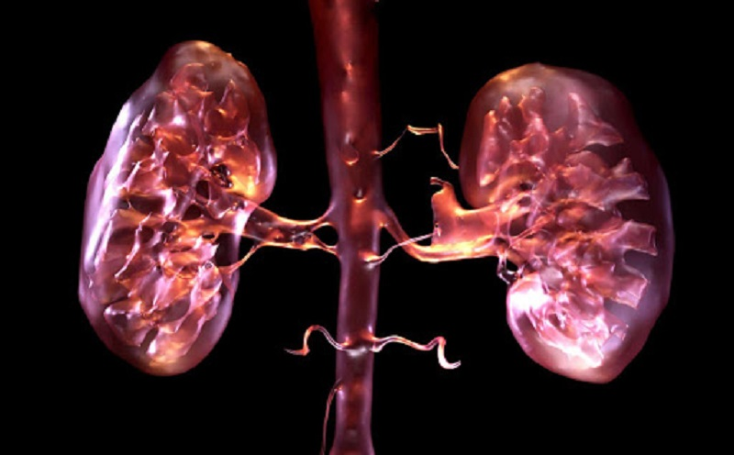
THE DANGER ELEMENTS
• Hypertension : if high blood pressure can worsen diabetic retinopathy and cause premature proliferative diabetic retinopathy (PDR-proliferative diabetic retinopathy) in both types 1 and 2 diabetes. • Kidney disease: if combined with diabetes worsens retinopathy. Conversely, treatment of kidney disease (such as a kidney transplant) can improve retinopathy and better response to photocoagulation. • Other risk factors include: smoking, obesity and hyperlipidemia.

Slide 6
CLASSIFY
The following classification of the Early treatment diabetic retinopathy study – ETDRS:
Background Diabetic Retinopathy (BDR) is characterized by microaneurysms, punctate hemorrhages, and exudates. Those are early signs of diabetic retinopathy, persisting and appearing more as the disease progresses.
Diabetic Maculopathy: The disease occurs in the central retina, especially macular edema and ischemia, affecting vision.
Preproliferative diabetic retinopathy (PPDR): manifested by flaccid discharge, venous changes, abnormal microangiopathy, often deep retinal hemorrhage. Pre-proliferative retina presents with advanced retinal ischemia with a high risk of retinal neovascularization.
Proliferative diabetic retinopathy (PDR) is characterized by neovascularization on the optic disc or 1 diameter of the optic disc on the retina.
Advanced diabetic eye disease: characterized by traction retinal detachment, severe vitreous hemorrhage, and neovascular glaucoma.

Slide 7
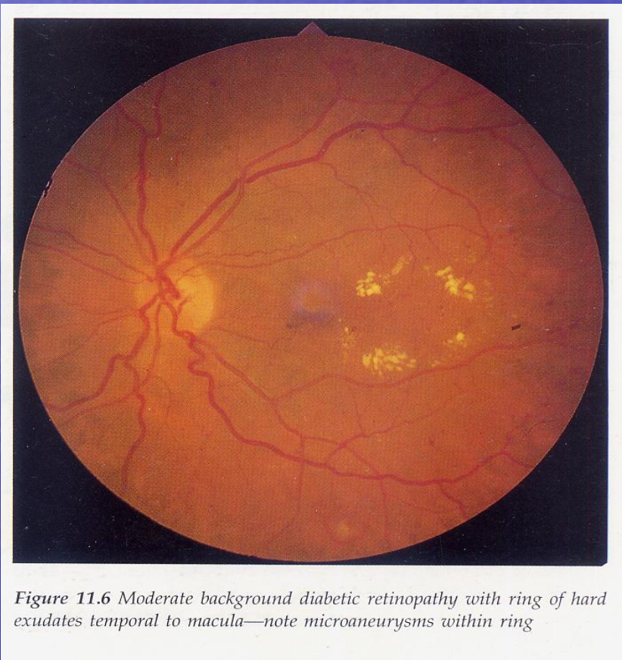
BACKGROUND DIABETIC RETINOPATHY

Slide 8
DIABETIC MACULOPATHY

Slide 9
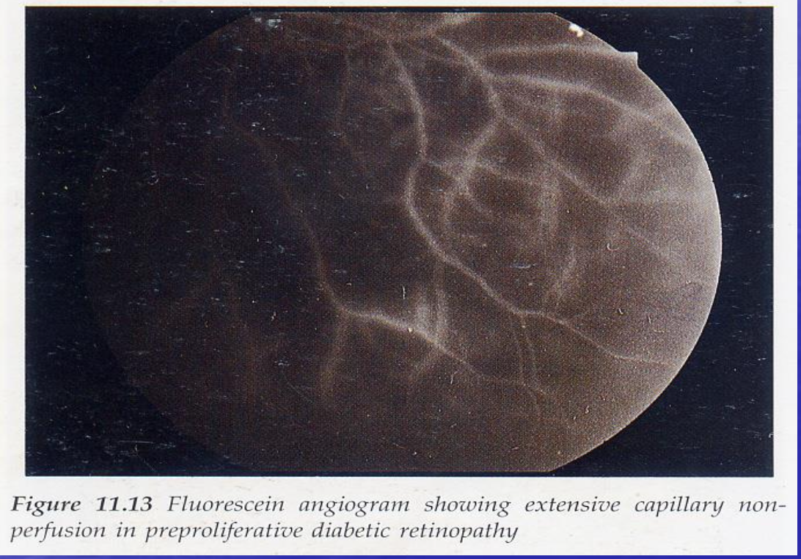
PREPROLIFERATIVE DIABETIC RETINOPATHY

Slide 10
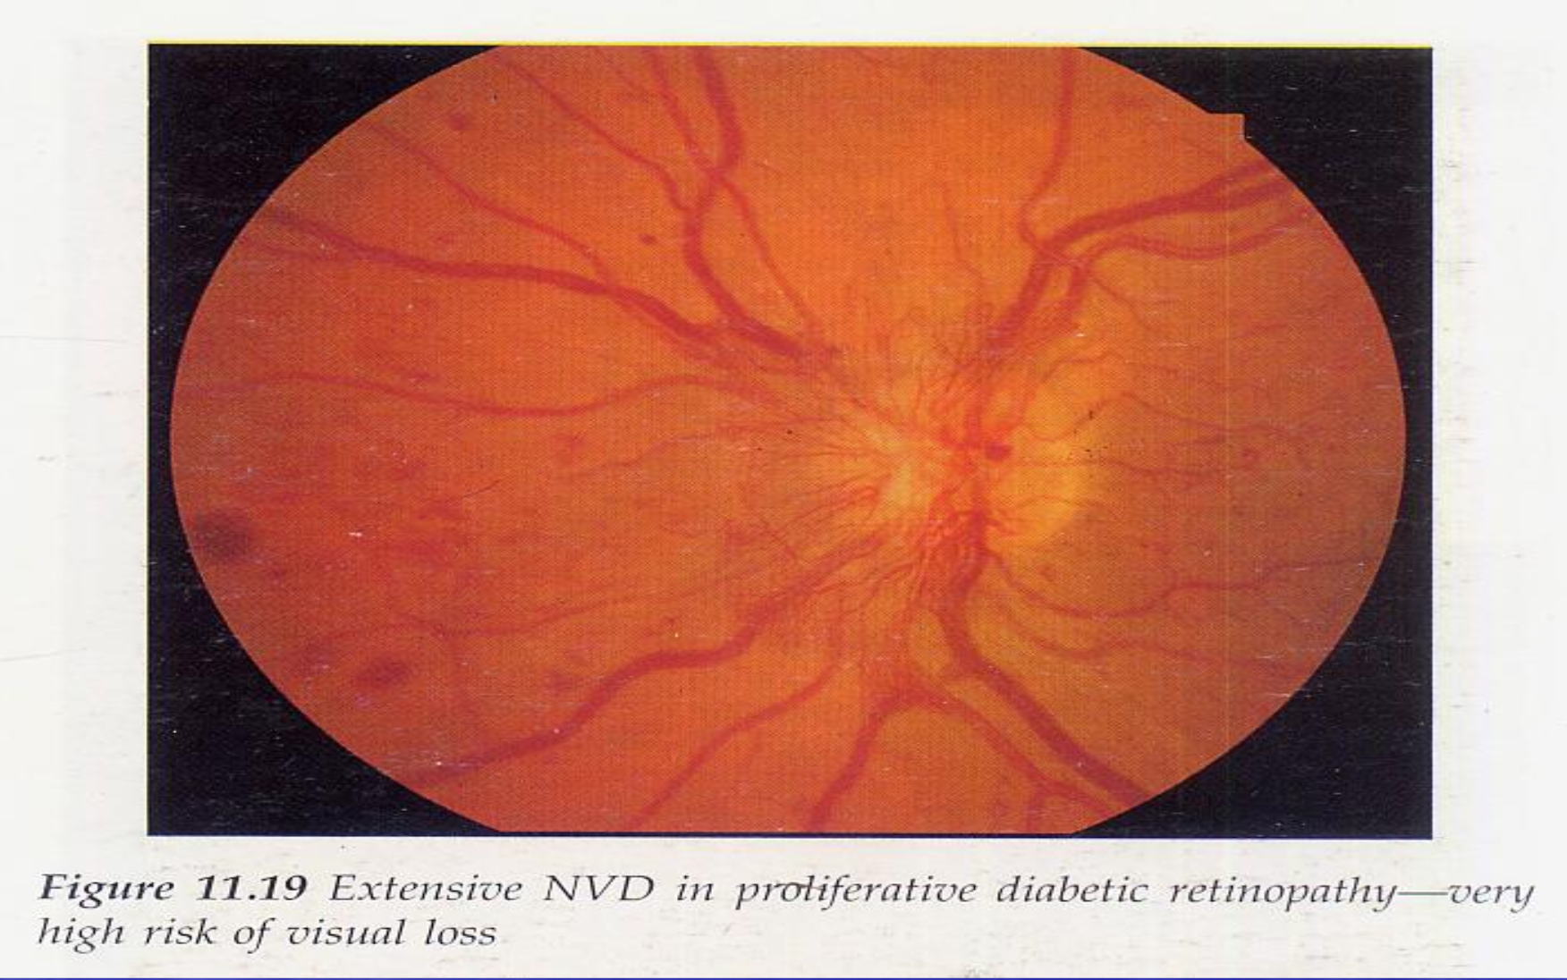
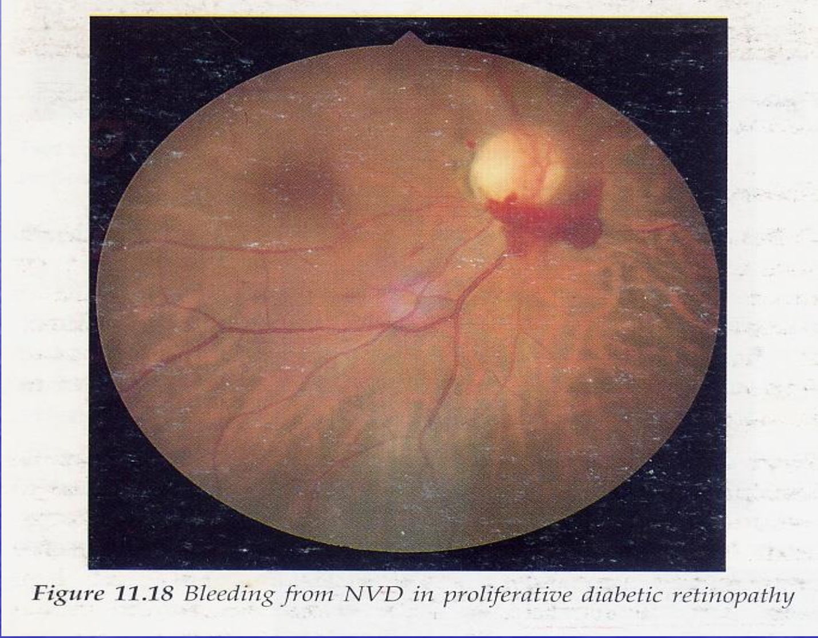
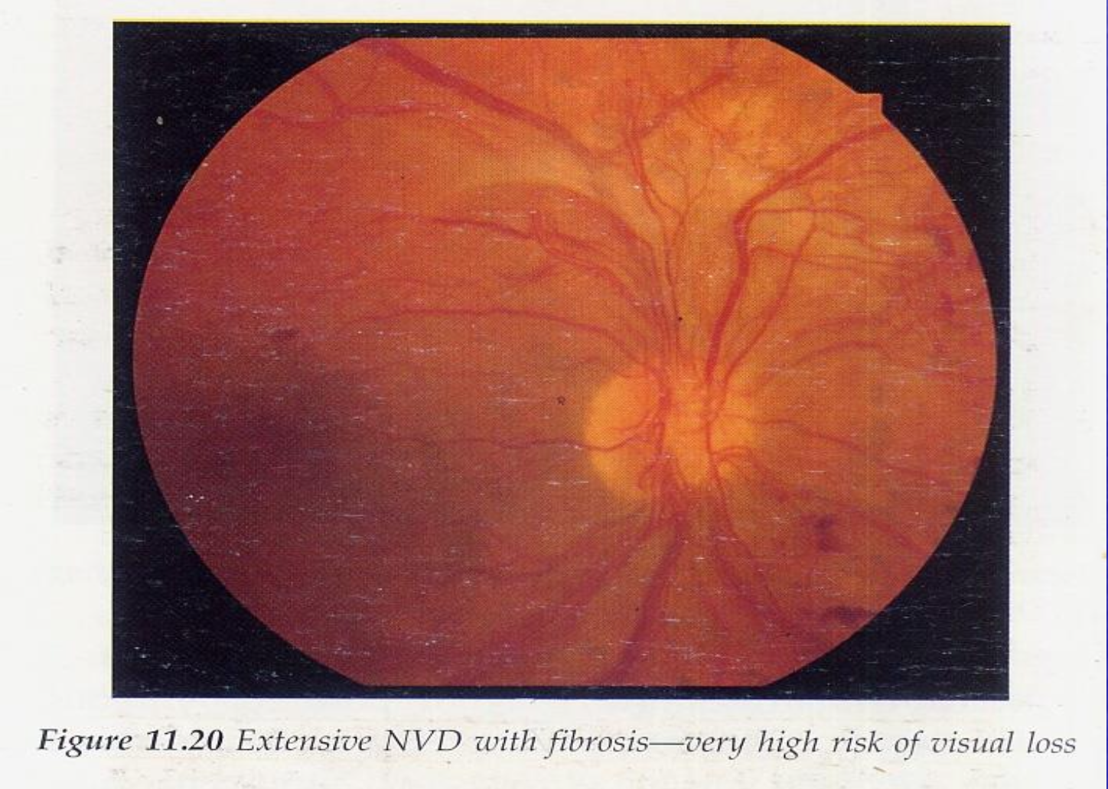
PROLIFERATIVE DIABETIC RETINOPATHY

Slide 11
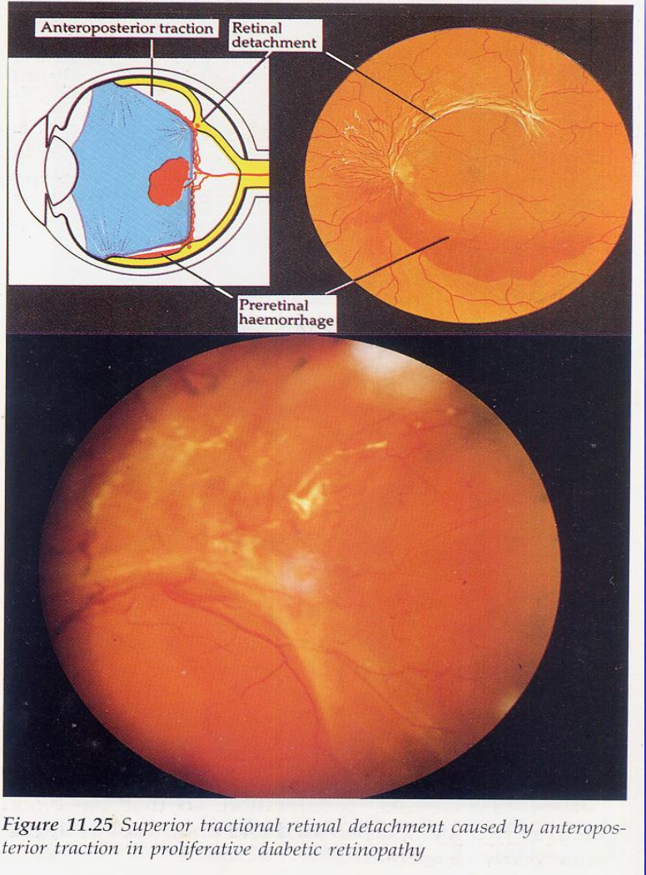
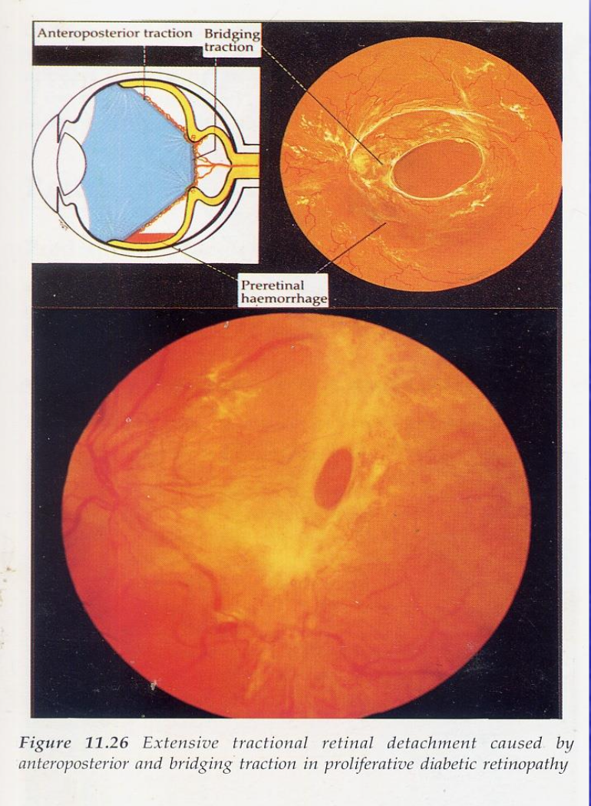
ADVANCED DIABETIC EYE DISEASE

Slide 12
TREATMENT
Patient education is important. In type 2 diabetes includes counseling on weight loss programs and the role of exercise.
Optimal diabetes control.
Other risk factors, particularly hypertension (especially type 2 diabetes) and high blood lipids, should be controlled with the diabetes physician.
Fenofibrate 200 mg daily may reduce the progression of diabetic retinopathy in type 2 diabetes and should be considered when prescribing. The decision depends on whether the patient is already on lipid-lowering medication.
Smoking should be stopped, although an effect on retinopathy has not been definitively established.
Other modifiable factors such as anemia and kidney disease should be considered if necessary.
The key to preventing diabetic retinopathy is patient education and long-term glycemic control.
Besides, retinal photocoagulation, vitreous injection anti-VEGF, Pars plana vitrectomy for the treatment of diabetic retinopathy.

Slide 13
THANK YOU !

